Slide 1
Unit-II Parser

Slide 2
Syntax Analyzer
Syntax Analyzer creates the syntactic structure of the given source program.
This syntactic structure is mostly a parse tree.
Syntax Analyzer is also known as parser.
The syntax of a programming is described by a context-free grammar (CFG).

Slide 3
Role of a Parser
Parser works on a stream of tokens.
The smallest item is a token.
Parser takes the input string S from Lexical analyzer and construct parse tree if S is a sentence of CFG G.
source
program
Lexical Analyzer
token
Parser
parse tree
get next token

Slide 4
Context-Free Grammar
Context-free grammar is a 4 tuple denoted as:
G=(V, T, P, S)
Where:
-V is a finite set of symbols called as non-terminals or variables,
-T is a finite set of symbols called as terminals,
-P is a finite set of productions rules in the following form
P: α → β
where α is a non-terminal and
β ∈ (V ∪ T)*
-S is a start symbol (one of the non-terminal symbol)
Example: S → aSa| bSb | ε
G=( {S}, {a , b}, P, S) where P contains:
P= { S → aSa,
S → bSb,
S → ε
}

Slide 5
Derivations
A sequence of replacements of non-terminal symbols is called a derivation. (2 types)
If we always choose the left-most non-terminal in each derivation step, this derivation is called as left-most derivation.
If we always choose the right-most non-terminal in each derivation step, this derivation is called as right-most derivation.
Example:
E → E + E | E – E | E * E | E / E | - E
E → ( E )
E → id
Derivations for the string –(id+id)

Slide 6
Left-Most and Right-Most Derivations
Left-Most Derivation
E ⇒ -E
⇒ -(E)
⇒ -(E+E)
⇒ -(id+E)
⇒ -(id+id)
Right-Most Derivation
E ⇒ -E
⇒ -(E)
⇒ -(E+E)
⇒ -(E+id)
⇒ -(id+id)
rm
lm
rm
lm
rm
lm
rm
rm
lm
lm

Slide 7
Parse Tree
A parse tree can be seen as a graphical representation of a derivation.
Interior nodes of a parse tree are non-terminal symbols.
The leaves of a parse tree are terminal symbols.
E ⇒ -E
E
⇒ -(E)
E
E
⇒ -(E+E)
-
E
-
E
-
E
(
E
)
(
E
)
E
E
E
+
E
-
E
-
E
⇒ -(id+E)
⇒ -(id+id)
(
E
)
(
E
)
E
+
E
E
+
E
id
id
id

Slide 8
Derivations
1)Consider the grammar
E → E + E | E – E | E * E | E / E | a | b
Construct Left most derivation ,right most derivation and parse trees for the string a + b * a+ b
2) Consider the grammar
S → aAS | a
A → SbA | SS | ba
Construct Left most derivation ,right most derivation and parse trees for the strings abaa and aabbaa
3) Consider the following grammar
S→(L) | a
L→L,S | S
Construct Leftmost derivation and parse tree for the string
i) (a, a)
ii) (a, (a, a))
iii) (a, ((a, a), (a, a)))

Slide 9
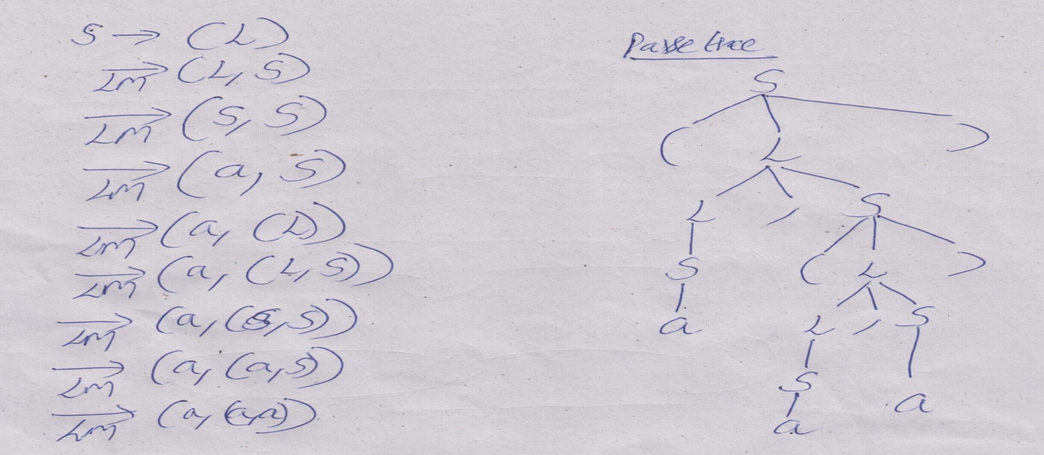
Consider the following grammar
S→(L) | a L→L,S | S
Construct Leftmost derivation and parse tree for the string (a, (a, a)).

Slide 10
Ambiguous Grammar
For some strings there exist more than one parse tree
Or more than one leftmost derivation
Or more than one rightmost derivation

Slide 11
Ambiguous Grammar
Example:
E → E + E | E * E | id , string is: id + id * id
E ⇒ E+E
⇒ id+E
⇒ id+E*E
⇒ id+id*E
⇒ id+id*id
E ⇒ E*E
⇒ E+E*E
⇒ id+E*E
⇒ id+id*E
⇒ id+id*id
E
E
E
+
E
E
*
E
id
E
*
E
E
+
E
id
id
id
id
id

Slide 12
Ambiguous Grammar
Show that the following grammar is ambiguous
S → aS | Sa |a
S → 0S1 | SS | ε
S → AB | aaB
A → a | Aa
B → b

Slide 13
Ambiguity
For the most parsers, the grammar must be unambiguous.
unambiguous grammar
➔ unique selection of the parse tree for a sentence
We should eliminate the ambiguity in the grammar during the design phase of the compiler.
An unambiguous grammar should be written to eliminate the ambiguity.
We have to prefer one of the parse trees of a sentence (generated by an ambiguous grammar) to disambiguate that grammar to restrict to this choice.

Slide 14
Left-Recursion
A grammar is said to be left recursive, if the grammar is of the form
A → A α | β
⇓ eliminate immediate left recursion
A → β A’
A’ → α A’ | ε an equivalent grammar
In general,
A → A α₁ | ... | A α_{m} | β₁ | ... | β_{n}
⇓ eliminate immediate left recursion
A → β₁ A’ | ... | β_{n} A’
A’ → α₁ A’ | ... | α_{m} A’ | ε an equivalent grammar

Slide 15
Immediate Left-Recursion -- Example
E → E+T | T
T → T*F | F
F → (E) | id
⇓ eliminate immediate left recursion
E → T E’
E’ → +T E’ | ε
T → F T’
T’ → *F T’ | ε
F → (E) | id

Slide 16
Left-Recursion -- Problem
A grammar cannot be immediately left-recursive, but it still can be
left-recursive.
By just eliminating the immediate left-recursion, we may not get
a grammar which is not left-recursive.
S → Aa | b
A → Sc | d This grammar is not immediately left-recursive,
but it is still left-recursive.
S ⇒ Aa ⇒ Sca or
A ⇒ Sc ⇒ Aac causes to a left-recursion
So, we have to eliminate all left-recursions from our grammar

Slide 17
Eliminate Left-Recursion -- Example
S → Aa | b
A → Ac | Sd | f
- Replace A → Sd with A → Aad | bd
So, we will have A → Ac | Aad | bd | f
- Eliminate the immediate left-recursion in A
A → bdA’ | fA’
A’ → cA’ | adA’ | ε
So, the resulting equivalent grammar which is not left-recursive is:
S → Aa | b
A → bdA’ | fA’
A’ → cA’ | adA’ | ε

Slide 18
Left-Recursion – Example 1
1)
E → E+T | T
T → T*F | F
F → (E) | id
After eliminating left recursion
E → T E’
E’ → +T E’ | ε
T → F T’
T’ → *F T’ | ε
F → (E) | id

Slide 19
Left-Recursion – Example 2,3
2)
A → Aa | bd
3)
S → (L)|a
L → L,S|S
After eliminating left recursion
A → bdA’
A’ → aA’|ε
After eliminating left recursion
S → (L)|a
L → SL’
L’ →,SL’| ε

Slide 20
Left-Recursion – Example 4
4)
S → Aa | b
A → Ac | Aad | bd | ε
After eliminating left recursion
S → Aa | b
A → bdA’| A’
A’ → cA’| adA’| ε

Slide 21
Left-Factoring
A grammar is said to be left factoring, if there is a production
A → αβ₁ | αβ₂
After eliminating Left Factoring
A → αA’
A’ → β₁ | β₂
In general,
A → αβ₁ | ... | αβ_{n} | γ₁ | ... | γ_{m}
convert it into
A → αA’ | γ₁ | ... | γ_{m}
A’ → β₁ | ... | β_{n}

Slide 22
Left-Factoring – Example 1,2
1)
A → abcC | abcD
C → ac
D → da
2)
S → iEtS | iEtSeS | a
E → b
After eliminating Left Factoring
A → abcA’
A’ → C|D
C → ac
D → da
After eliminating Left Factoring
S → iEtSS’ | a
S’→ ε|eS
E → b

Slide 23
Left-Factoring – Example 3
3)
A → abB | aB | cdg | cdeB | cdfB
⇓
A → aA’ | cdg | cdeB | cdfB
A’ → bB | B
⇓
A → aA’ | cdA’’
A’ → bB | B
A’’ → g | eB | fB

Slide 24
Left-Factoring – Example 4
4)
A → ad | a | ab | abc | b
⇓
A → aA’ | b
A’ → d | ε | b | bc
⇓
A → aA’ | b
A’ → d | ε | bA’’
A’’ → ε | c

Slide 25
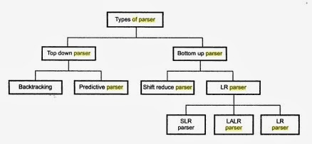


Types of Parsers

Slide 26
Types of Parsers
We categorize the parsers into two groups:
Top-Down Parser
- constructs the parse tree from the root node to leaf node.
- In this parsing, we find left most derivation for the input string.
Bottom-Up Parser
-the parse is created bottom to top; starting from the leaves
- This parsing attempts to find right most derivation in reverse order.
Both top-down and bottom-up parsers scan the input from left to right (one symbol at a time).

Slide 27
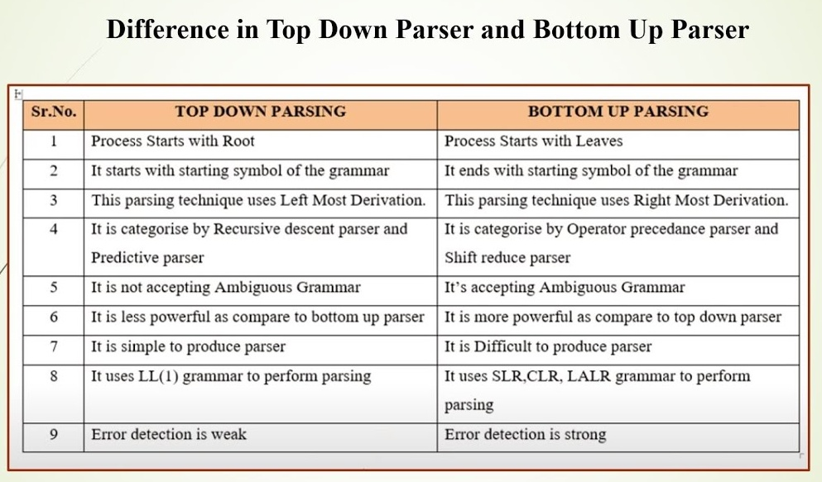

Slide 28
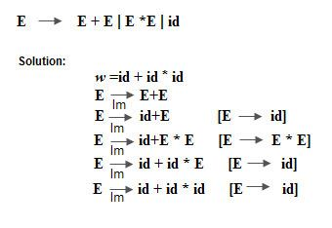
Top-Down Parsing
Constructs the parse tree from the root node to leaf node.
In this parsing, we find left most derivation for the input string.
Top-down parsers scan the input from left to right (one symbol at a time).
It cannot handle Left recursive grammars.

Slide 29
Brute Force Parsing (Backtracking)
It applies the first production of the starting symbol S.
Then, within this string, BFPT identifies the leftmost non-terminal and applies the first alternative for that non-terminal.
Repeat step-2 until there is no non-terminal present in the string. The string may be accepted or may not be accepted.
If the string is not accepted, then it will identify the most recently expanded non-terminal and applies the second alternative for that non-terminal.
Step-4 is repeated until all the alternatives are applied.

Slide 30
Brute Force Parsing Example 1
S->cAd
A->ab | a
Input String: cad
S
S
S
c
A
d
c
A
d
c
A
d
a
b
a
fails, backtrack

Slide 31
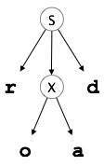
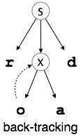
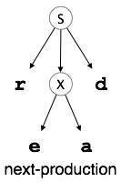
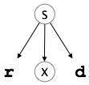
Brute Force Parsing Example 2
S → rXd | rZd
X → oa | ea
Z → ai
input string: read

Slide 32
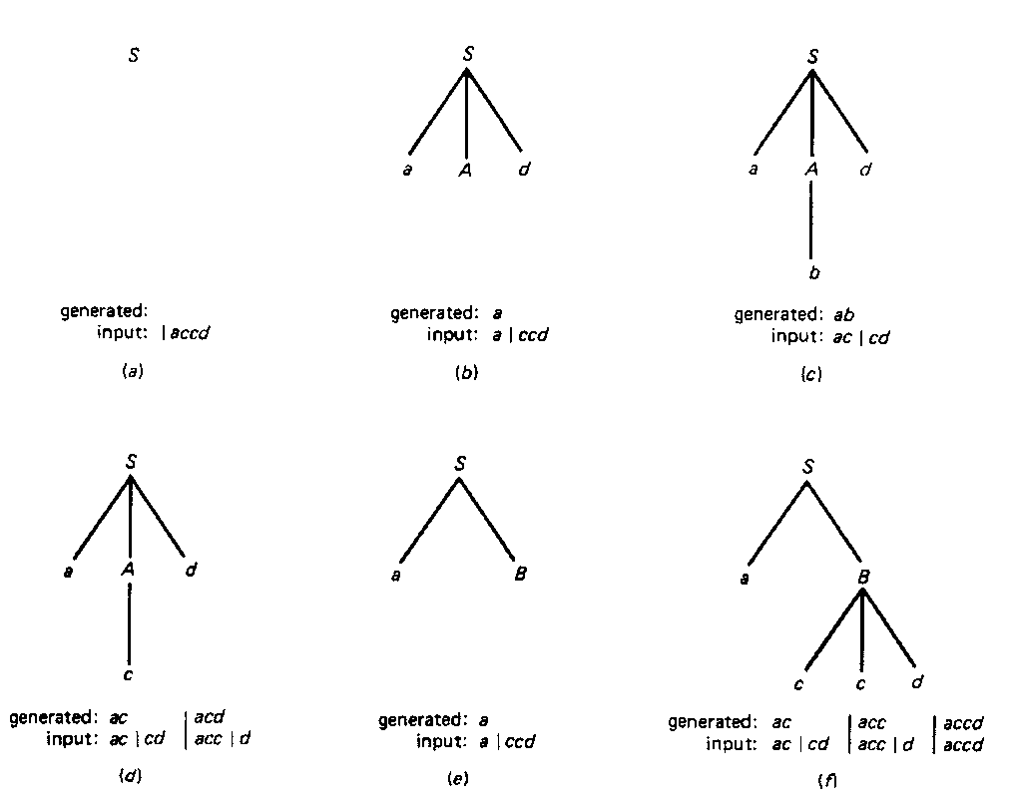
Brute Force Parsing Example 3

Slide 33
Problems with Top-Down Parsing
Backtracking
Left recursion
Order of alternatives

Slide 34
Recursive Descent Parsing
A parser that uses collection of recursive procedures for parsing the given input string is called recursive descent parser.
Each non-terminal corresponds to a procedure.
Execution begins with the procedure for start symbol.
Ex: A → aBb (This is only the production rule for A)
proc A {
- match the current token with a, and move to the next token;
- call ‘B’;
- match the current token with b, and move to the next token;
}

Slide 35
Recursive Descent Parsing Example 1
1)
E → E+T | T
T → T*F | F
F → (E) | id
After eliminating left recursion
E → T E’
E’ → +T E’ | ε
T → F T’
T’ → *F T’ | ε
F → (E) | id

Slide 36
Recursive Descent Parsing Example 1
Procedure E( )
{
T( );
Eprime( );
}
Procedure Eprime( )
{
if(input_symbol = '+')
{
advance( );
T( );
Eprime( );
}
}
Procedure T( )
{
F( );
Tprime( );
}
Procedure Tprime( )
{
if(input_symbol = '*')
{
advance( );
F( );
Tprime( );
}
}
Procedure F( )
{
if(input_symbol='(')
{
advance( );
E( );
if(input_symbol = ')' )
advance( );
else
error( );
}
else if(input_symbol = 'id')
{
advance( );
}
else
error( );
}

Slide 37
Recursive Descent Parsing Example 2
2)
bexpr → bexpr or bterm | bterm
bterm → bterm and bfactor | bfactor
bfactor → not bfactor | ( bexpr ) | true | false
E → E+T | T
T → T*F | F
F → !F | (E) | true|false
After eliminating left recursion
E → T E’
E’ → +T E’ | ε
T → F T’
T’ → *F T’ | ε
F → !F | (E) | true|false

Slide 38
Recursive Descent Parsing Example 2
Procedure E()
{
T( );
Eprime( );
}
Procedure Eprime( )
{
if(input_symbol = '+')
{
advance( );
T( );
Eprime( );
}
}
Procedure T( )
{
F( );
Tprime( );
}
Procedure Tprime( )
{
if(input_symbol = '*')
{
advance( );
F( );
Tprime( );
}
}
Procedure F( )
{
if(input_symbol = '!')
{
advance( );
F( );
}
else if(input_symbol='(')
{
advance( );
E( );
if(input_symbol = ')' )
advance( );
else
error( );
}
else if(true)
{
return(true);
}
else if(false)
{
return(false);
}
else
error( );
}

Slide 39
Predictive Parser
Predictive Parsing
no backtracking
efficient
needs a special form of grammars (LL(1) grammars).
Recursive Predictive Parsing is a special form of Recursive Descent parsing without backtracking.
Non-Recursive (Table Driven) Predictive Parser is also known as LL(1) parser.

Slide 40
Predictive Parsing
Compute FIRST and FOLLOW function.
Construct Predictive Parsing Table.
Parse the input string

Slide 41
Predictive Parsing
Two functions are used in the construction of Predictive parsing tables:
FIRST FOLLOW
FIRST(α) is a set of the terminal symbols which occur as first symbols in strings derived from α where α is any string of grammar symbols.
if α derives to ε, then ε is also in FIRST(α) .
FOLLOW(A) is the set of the terminals which occur immediately after (follow) the non-terminal A in the strings derived from the starting symbol.
a terminal a is in FOLLOW(A) if S ⇒ αAaβ

Slide 42
Rules for calculating FIRST
If X is a terminal symbol then FIRST(X)={X}
If X → ε is a production then FIRST(X)={ε}
If X is a non-terminal symbol and X → Y₁Y₂Y₃ is a production
FIRST(X)={Y₁} if Y₁ is a terminal.
Otherwise
FIRST(X)= FIRST{Y₁Y₂Y₃}=FIRST(Y₁),if FIRST(Y₁) doesn’t contains ε.
If FIRST(Y1) contains ε then
FIRST(X)= FIRST{Y₁Y₂Y₃}=FIRST(Y₁) - {ε} ∪ FIRST(Y₂Y₃).
FIRST(Y₂Y₃) is computed in similar manner.

Slide 43
EXAMPLE
FIRST(A)= {d} U FIRST(BC)
= {d} U FIRST(B) –{∈} U FIRST(C)
= {d} U {g, ∈ } – {∈} U {h, ∈ }
= {d} U {g} U {h, ∈ }
= {d,g,h, ∈}
S → ACB |CbB | Ba
A → da | BC
B → g | ∈
C → h | ∈
FIRST(S) = FIRST(ACB) U FIRST(CbB) U FIRST(Ba)
FIRST(A)= FIRST(da) U FIRST(BC)
= {d} U FIRST(BC)
FIRST(B)= FIRST(g) U FIRST(∈ )
= {g} U {∈ }
= {g, ∈ }
FIRST(C)= FIRST(h) U FIRST(∈ )
= {h} U {∈ }
= {h, ∈ }
FIRST(ACB)= FIRST(A) – {∈} U FIRST(CB)
= {d,g,h, ∈} – {∈} U FIRST(CB)
= {d,g,h} U FIRST(C) – {∈} U FIRST(B)
= {d,g,h} U {h} U {g, ∈ } = {d,g,h, ∈}
FIRST(CbB)= FIRST(C) – {∈} U FIRST(bB)
= {h} U {b}
= {b,h}
FIRST(Ba)= FIRST(B) – {∈} U FIRST(a)
= {g} U {a}
= {a,g}
FIRST(S)= {d,g,h, ∈} U {b,h} U {a,g}
= {a,b,d,g,h, ∈}

Slide 44
Rules for calculating FOLLOW(for non-terminals)
If S is the start symbol then add $ to FOLLOW(S)
If A → αBβ is a production then
FOLLOW(B) =FIRST(β)
if FIRST(β) contains ε then add FOLLOW(A) to FOLLOW(B)
i.e., FOLLOW(B) =FIRST(β) - {ε} ∪ FOLLOW(A).
If A → αB is a production FOLLOW(B) = FOLLOW(A).
We apply these rules until nothing more can be added to any follow set.

Slide 45
Constructing Predictive Parsing Table -- Algorithm
For each production A → α do steps 2,3 and 4
For each terminal a in FIRST(α), add A → α to M[A,a]
If ε in FIRST(α) , add A → α to M[A,b] where b is the terminal in FOLLOW(A)
If ε is in FIRST(α) and $ is in FOLLOW(A) , add A → α to M[A, $].
All other undefined entries of the parsing table are error entries.

Slide 46
Predictive Parsing Table Example 1
1)Construct Predictive Parsing Table for the following grammar
E → E+T | T
T → T*F | F
F → (E) | id
After eliminating left recursion
E → T E’
E’ → +T E’|ε
T → F T’
T’ → *F T’|ε
F → (E) | id
Non-Terminals - {E, E’, T, T’, F}
Terminals - {+, *, (, ), id}

Slide 47
FIRST SET
E → TE’
E’ → +TE’|ε
T → FT’
T’ → *FT’|ε
F → (E)|id
FIRST(E) = FIRST(TE’)
= FIRST(T)
={(,id}
FIRST(E’) = FIRST(+TE’ ) U FIRST(ε)
= {+,ε}
FIRST(T) = FIRST(FT’)
= FIRST(F)
= {(,id}
FIRST(T’) = FIRST(*FT’) U FIRST(ε)
= {*,ε}
FIRST(F) = FIRST((E)) U FIRST(id)
= { (, id}

Slide 48
3)Using E → TE’
FOLLOW(T) = FIRST( E’ )
= { +, ε} –{ε} U FOLLOW(E)
= { +, ), $)
Using E → +TE’
FOLLOW(T) = FIRST( E’ ) = { +, ), $)
FOLLOW SET
E → TE’
E’ → +TE’ |ε
T → FT’
T’ → *FT’|ε
F → (E) |id
1)we have to add $ to the starting symbol
i.e., FOLLOW(E) = { $ }
Using F → (E)
FOLLOW(E) = FIRST( ) ) = { ) }
=>FOLLOW(E) = { ), $ }
2)Using E → TE’
FOLLOW(E’) = FOLLOW(E)
= { ), $ }
Using E’ → +TE’
FOLLOW(E’) = FOLLOW(E’)
= { ), $ }
4)Using T → FT’
FOLLOW(T’) = FOLLOW(T)
= { +, ), $ }
Using T’ → *FT’
FOLLOW(T’) = FOLLOW(T’) ={ +, ), $ }
5)Using T → FT’
FOLLOW(F) = FIRST( T’ )
= { *, ε} –{ε} U FOLLOW(T)
= { *,+, ), $)
Using T’ → *FT’
FOLLOW(F) = FIRST( T’ )
= { *, ε} –{ε} U FOLLOW(T’)
= { *,+, ), $)

Slide 49
Constructing Predictive Parsing Table
E → TE’ FIRST(TE’)={(,id} ➔ E → TE’ into M[E,(] and M[E,id]
E’ → +TE’ FIRST(+TE’ )={+} ➔ E’ → +TE’ into M[E’,+]
E’ → ε FIRST(ε)={ε}
but since ε in FIRST(ε)
and FOLLOW(E’)={$,)} ➔ E’ → ε into M[E’,$] and M[E’,)]
T → FT’ FIRST(FT’)={(,id} ➔ T → FT’ into M[T,(] and M[T,id]
T’ → *FT’ FIRST(*FT’ )={*} ➔ T’ → *FT’ into M[T’,*]
T’ → ε FIRST(ε)={ε}
but since ε in FIRST(ε)
and FOLLOW(T’)={$,),+} ➔ T’ → ε into M[T’,$], M[T’,)] and M[T’,+]
F → (E) FIRST((E) )={(} ➔ F → (E) into M[F,(]
F → id FIRST(id)={id} ➔ F → id into M[F,id]

Slide 50
Predictive Parsing Table
 | id | + | * | ( | ) | $
E | E → TE’ |  |  | E → TE’
E’ |  | E’ → +TE’ |  |  | E’ → ε | E’ → ε
T | T → FT’ |  |  | T → FT’
T’ |  | T’ → ε | T’ → *FT’ |  | T’ → ε | T’ → ε
F | F → id |  |  | F → (E)

Slide 51
Predictive Parsing Table Example 2
2)Construct Predictive Parsing Table for the following grammar
S→iEtS | iEtSeS| a
E→b
After eliminating left factoring
S→iEtSS’|a
S’→ eS | ε
E→b

Slide 52
FOLLOW:
S→iEtSS’|a
S’→ eS | ε
E→b
1)FOLLOW(S) = { $ }
Using S→iEtSS’
FOLLOW(S) = FIRST(S’)
= {e, ε }-{ε} U FOLLOW(S)
= { e, $ }
Using S’→eS
FOLLOW(S) = FOLLOW(S’)
= { e, $ }
2)Using S→iEtSS’
FOLLOW(S’) = FOLLOW(S)
= { e, $ }
3)Using S→iEtSS’
FOLLOW(E) = FIRST(tSS’)
= {t}
FIRST:
FIRST(S) = FIRST(iEtSS’) U FIRST(a)
= { i, a }
FIRST(S’) = FIRST(eS) U FIRST(ε)
={e, ε }
FIRST(E) = FIRST(b)
={ b}

Slide 53
Predictive Parsing Table
 | a | b | e | i | t | $
S | S → a |  |  | S → iEtSS’
S’ |  |  | S’ → e S S’ → ε |  |  | S’ → ε
E |  | E → b

Slide 54
Predictive Parsing Table Example 3
3)Construct Predictive Parsing Table for the following grammar
E → E+T | T
T → T*F | F
F → F* | a | b
After eliminating left recursion
E → T E’
E’ → +T E’|ε
T → F T’
T’ → *F T’|ε
F → aF’| bF’
F’ → *F’ |ε

Slide 55
Predictive Parsing Table
 | + | * | a | b | $
E |  |  | E → TE’ | E → TE’
E’ | E’ → +TE’ |  |  |  | E’ → ε
T |  |  | T → FT’ | T → FT’
T’ | T’ → ε | T’ → *FT’ |  |  | T’ → ε
F |  |  | F → aF’ | F → bF’
F’ | F’ → ε | F’ → *F’ | ε |  |  | F’ → ε

Slide 56
Predictive Parsing Table Example 4
4)Construct Predictive Parsing Table for the following grammar
S → aABb
A → c| ε
B → d|ε

Slide 57
Predictive Parsing Table
Step 1:No left recursion in the grammar, hence no modification required.
Step 2:Calculation of First Set:
First(S) = { a }
First(A) = { c,∈ }
First(B) = { d,∈ }
Step 3:Calculation of Follow Set:
Follow(S) = { $ }
Follow(A) = { d , b }
Follow(B) = { b }
 | a | b | c | d | $
S | S → aABb
A |  | A→ ε | A →c | A→ ε
B |  | B→ ε |  | B→ d

Slide 58
Non-Recursive Predictive Parsing
Non-Recursive predictive parsing is a table-driven parser.
It is a top-down parser.
It is also known as LL(1) Parser.
input buffer
stack Non-recursive output
Predictive Parser
Parsing Table

Slide 59
input buffer
our string to be parsed. We will assume that its end is marked with a special symbol $.
stack
contains the grammar symbols
at the bottom of the stack, there is a special end marker symbol $.
initially the stack contains only the symbol $ and the starting symbol S. $S ⬅ initial stack
when the stack is emptied (ie. only $ left in the stack), the parsing is completed.
parsing table
a two-dimensional array M[A,a]
each row is a non-terminal symbol
each column is a terminal symbol or the special symbol $
each entry holds a production rule.
output
a production rule representing a step of the derivation sequence (left-most derivation) of the string in the input buffer.

Slide 60
Parser Actions
The symbol at the top of the stack (say X) and the current symbol in the input string (say a) determine the parser action.
There are four possible parser actions.
If X =a = $ ➔ parser halts (successful completion)
If X=a ≠ $
➔ parser pops X from the stack, and advances input pointer to the next symbol.
If X is a non-terminal
➔ parser looks at the parsing table entry M[X,a]. If M[X,a] holds a production rule X→Y₁Y₂...Y_{k}, it pops X from the stack and pushes Y_{k},Y_{k-1},...,Y₁ into the stack.
none of the above ➔ error

Slide 61
Example 1:Steps involved in parsing the string : id+id
stack input output
$E id+id$ E → TE’
$E’T id+id$ T → FT’
$E’ T’F id+id$ F → id
$ E’ T’id id+id$ pop id and advance i/p
pointer to next position.
$ E’ T’ +id$ T’ → ε
$ E’ +id$ E’ → +TE’
$ E’ T+ +id$ pop + and advance
$ E’ T id$ T → FT’
$ E’ T’ F id$ F → id
$ E’ T’id id$ pop id and advance
$ E’ T’ $ T’ → ε
$ E’ $ E’ → ε
$ $ accept
 | id | + | * | ( | ) | $
E | E → TE’ |  |  | E → TE’
E’ |  | E’ → +TE’ |  |  | E’ → ε | E’ → ε
T | T → FT’ |  |  | T → FT’
T’ |  | T’ → ε | T’ → *FT’ |  | T’ → ε | T’ → ε
F | F → id |  |  | F → (E)

Slide 62
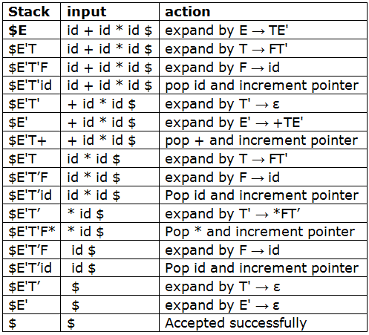
Steps involved in parsing the string : id+id*id

Slide 63
Example2:Steps involved in parsing the string : abba
S → aBa Predictive Parsing
B → bB | ε Table
stack input output
$S abba$ S → aBa
$aBa abba$
$aB bba$ B → bB
$aBb bba$
$aB ba$ B → bB
$aBb ba$
$aB a$ B → ε
$a a$
$ $ accept, successful completion
 | a | b | $
S | S → aBa
B | B → ε | B → bB

Slide 64
LL(1) Grammar
A grammar whose parsing table has no multiply-defined entries is said to be LL(1) grammar.
one input symbol used as a look ahead symbol do determine parser action
LL(1) left most derivation
input scanned from left to right
The parsing table of a grammar may contain more than one production rule. In this case, we say that it is not a LL(1) grammar.

Slide 65
A Grammar which is not LL(1)
S → i E t S S’ | a FOLLOW(S) = { $,e }
S’ → e S | ε FOLLOW(S’) = { $,e }
E → b FOLLOW(E) = { t }
FIRST(iEtSS’) = {i}
FIRST(a) = {a}
FIRST(eS) = {e}
FIRST(ε) = {ε}
FIRST(b) = {b}
two production rules for M[S’,e]
 | a | b | e | i | t | $
S | S → a |  |  | S → iEtSS’
S’ |  |  | S’ → e S S’ → ε |  |  | S’ → ε
E |  | E → b

Slide 66
Properties of LL(1) Grammars
A grammar G is LL(1) if and only if the following conditions hold for two distinctive production rules A → α | β
Both α and β cannot derive strings starting with same terminals.
At most one of α and β can derive to ε.
If β can derive to ε, then α cannot derive to any string starting with a terminal in FOLLOW(A).
(or)
For every pair of productions A→α|β
FIRST(α) ∩ FIRST(β)=∅
and if FIRST(β) contains ε, and FIRST(α) does not contain ε
then FIRST(α) ∩ FOLLOW(A)=∅

Slide 67
LL(1) Grammar Example1
1) Test whether the grammar is LL(1) or not.
S → AaAb |BbBa
A → ∈
B → ∈
Sol)
For a pair of productions S → AaAb |BbBa
FIRST (AaAb) ∩ FIRST(BbBa)
FIRST (AaAb)= FIRST(A) –{∈} U FIRST(aAb)
= {a}
FIRST (BbBa)= FIRST(B) –{∈} U FIRST(bBa)
= {b}
FIRST (AaAb) ∩ FIRST(BbBa)={a} ∩ {b}= ∅
Hence, the grammar is LL(1)

Slide 68
LL(1) Grammar Example2
2) Test whether the grammar is LL(1) or not.
S → 1AB| ∈
A → 1AC|0C
B → 0S
C → 1
Sol)
For a pair of productions S → 1AB| ∈
FIRST (1AB) ∩ FIRST(∈) ={1} ∩ {∈} = ∅ and
FIRST (1AB) ∩ FOLLOW(S) ={1} ∩ {$} = ∅
For a pair of productions A → 1AC|0C
FIRST (1AC) ∩ FIRST(0C) ={1} ∩ {0} = ∅
Hence, the grammar is LL(1)

Slide 69
Examples
1)Construct LL(1) Parsing Table for the following grammar
S → AaAb |BbBa
A → ∈
B → ∈
2)Construct LL(1) Parsing Table for the following grammar
S → aBDh
B → cC
C → bC | ∈
D → EF
E → g | ∈
F → f |∈
3)Construct LL(1) Parsing Table for the following grammar
S → (L)|a
L → L,S|S
Parse the string (a,a)

Slide 70
LL(1) Parsing Table - 1
Step 1:No left recursion in the grammar, hence no modification required.
Step 2:First Set:
First(S) = { a , b }
First(A) = { ∈ }
First(B) = { ∈ }
Step 3:Follow Set:
Follow(S) = { $ }
Follow(A) = { a , b }
Follow(B) = { a , b }
 | a | b | $
S | S → AaAb | S → BbBa
A | A→ ε | A→ ε
B | B→ ε | B→ ε

Slide 71
LL(1) Parsing Table - 2
First Functions-
First(S) = { a }
First(B) = { c }
First(C) = { b , ∈ }
First(D) = { g , f , ∈ }
First(E) = { g , ∈ }
First(F) = { f , ∈ }
 | a | b | c | g | f | h | $
S | S → aBDh
B |  |  | B → cC
C |  | C → bC |  | C →∈ | C →∈ | C →∈
D |  |  |  | D → EF | D → EF | D → EF
E |  |  |  | E → g | E →∈ | E→∈
F |  |  |  |  | F → f | F→∈
Follow Functions-
Follow(S) = { $ }
Follow(B) = { g , f , h }
Follow(C) = { g , f , h }
Follow(D) = { h }
Follow(E) = { f , h }
Follow(F) = { h }

Slide 72
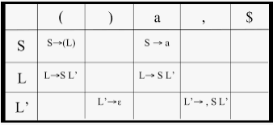
LL(1) Parsing Table - 3
Step 1: left recursion in the grammar.
S → (L) | a
L → SL’
L’ → ,SL’ |∈
First Functions-
First(S) = { ( , a }
First(L) = { ( , a }
First(L’) = { , , ∈ }
Follow Functions-
Follow(S) = { $ , , , ) }
Follow(L) = { ) }
Follow(L’) = { ) }

Slide 73
Error Recovery in Predictive Parsing
An error may occur in the predictive parsing (LL(1) parsing)
if the terminal symbol on the top of stack does not match with the current input symbol.
if the top of stack is a non-terminal A, the current input symbol is a, and the parsing table entry M[A,a] is empty.
What should the parser do in an error case?
The parser should be able to give an error message (as much as possible meaningful error message).
It should be recover from that error case, and it should be able to continue the parsing with the rest of the input.

Slide 74
Error Recovery Techniques
Panic-Mode Error Recovery
Skipping the input symbols until a synchronizing token is found.
Phrase-Level Error Recovery
Each empty entry in the parsing table is filled with a pointer to a specific error routine to take care that error case.

Slide 75
Panic-Mode Error Recovery in LL(1) Parsing
In panic-mode error recovery, we skip all the input symbols until a synchronizing token is found.
What is the synchronizing token?
All the terminal-symbols in the follow set of a non-terminal can be used as a synchronizing token set for that non-terminal.
So, a simple panic-mode error recovery for the LL(1) parsing:
If the entry is synch then the non-terminal on top of the stack is popped so that the parsing can continue.
To handle unmatched terminal symbols, the parser pops that unmatched terminal symbol from the stack and it issues an error message saying that that unmatched terminal is inserted.
If parser looks up entry M[A,a] as blank then the input symbol a is skipped.

Slide 76
Panic-Mode Error Recovery - Example
stack input output
$E +id*+id$ skip +
$E id*+id$ E → TE’
$E’T id*+id$ T → FT’
$E’ T’F id*+id$ F → id
$ E’ T’id id*+id$ pop id and advance i/p
pointer to next position.
$ E’ T’ *+id$ T’ → *FT’
$ E’T’F* *+id$ pop * and advance
$ E’T’F +id$ synch so pop F
$ E’T’ +id$ T’ → ε
$ E’ +id$ E’ → +TE’
$ E’ T+ +id$ pop + and advance
$ E’ T id$ T → FT’
$ E’ T’ F id$ F → id
$ E’ T’id id$ pop id and advance
$ E’ T’ $ T’ → ε
$ E’ $ E’ → ε
$ $ accept
 | id | + | * | ( | ) | $
E | E → TE’ |  |  | E → TE’ | synch | synch
E’ |  | E’ → +TE’ |  |  | E’ → ε | E’ → ε
T | T → FT’ | synch |  | T → FT’ | synch | synch
T’ |  | T’ → ε | T’ → *FT’ |  | T’ → ε | T’ → ε
F | F → id | synch | synch | F → (E) | synch | synch

Slide 77
Phrase-Level Error Recovery
Each empty entry in the parsing table is filled with a pointer to a special error routine which will take care that error case.
These error routines may:
change, insert, or delete input symbols.
issue appropriate error messages
pop items from the stack.
We should be careful when we design these error routines, because we may put the parser into an infinite loop.

Slide 78
FOLLOW EXAMPLE
S → ACB |CbB | Ba
A → da | BC
B → g | ∈
C → h | ∈
FOLLOW(S)={$}
Consider S → ACB
FOLLOW(B)= FOLLOW(S)={$}
Consider S → Ba
FOLLOW(B)= FIRST(a)={a}
Consider A → BC
FOLLOW(B)= FIRST(C)= {h, ∈}
FOLLOW(B)= {h, ∈} –{∈} U FOLLOW(A)
= {h,g, $}
Consider S → ACB
FOLLOW(A)= FIRST(CB)= FIRST(C) – {∈} U FIRST(B)={ g,h,∈}
FOLLOW(A)={ g,h, ∈} –{∈} U FOLLOW(S)= {g,h,$}
FOLLOW(B)= {a,g,h, $}

Slide 79
FOLLOW EXAMPLE
S → ACB |CbB | Ba
A → da | BC
B → g | ∈
C → h | ∈
Consider S → ACB
FOLLOW(C)= FIRST(B)={g, ∈} –{∈} U FOLLOW(S)={g, $}
Consider S → CbB
FOLLOW(C)= FIRST(bB)={b}
Consider A → BC
FOLLOW(C)= FOLLOW(A)
= {h,g, $}
FOLLOW(C)= {b,g,h, $}

Slide 80
END

